Slide 1




01 · PROBLEM STATEMENT
Fake bKash and Nagad messages cost Bangladeshi families real money every day
Messages people really get
bKash
You received Tk 5,000 by mistake. Return it now or your account will be closed.
+8801XXXXXXXXX
Your Nagad OTP is needed to verify your account. Share the code to avoid suspension.
Scams arrive by SMS and Messenger
Fake “wrong sends”, OTP and PIN requests, job offers with a fee, lottery wins and phishing links.
HR Jobs BD
Selected! Salary Tk 45,000. Pay Tk 1,500 registration fee to confirm.
The most at-risk have the least help
Parents and grandparents rarely get plain-language warnings, in Bangla, before they reply.
After a mistake, people freeze
Victims don't know who to call first or how to stop the next follow-up scam.
Lucky Draw
Congrats! You won an iPhone. Pay the courier charge to claim.
Notes:
Every day, people in Bangladesh get fake bKash and Nagad messages, OTP requests and job offers that are too good to be true. One wrong reply can wipe out a family's savings, and the people most at risk are the ones with the least access to plain-language warnings or to guidance after a mistake.

Slide 2
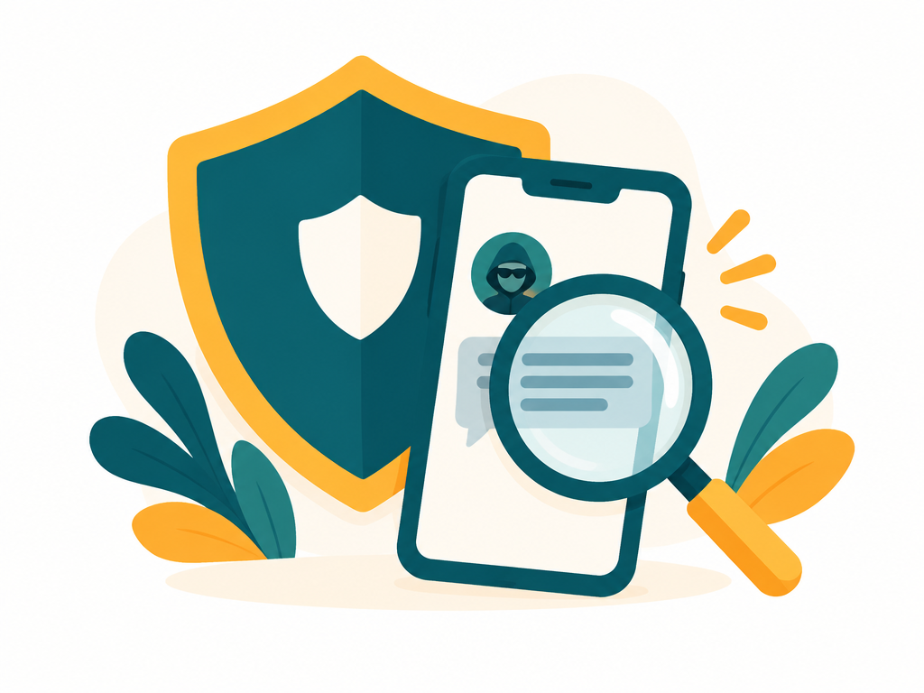



02 · PROPOSED SOLUTION
ScamShield BD: a free AI scam checker and recovery assistant
Spot the scam before it costs you, and recover fast if it already has.
Check
Practice
Get Help
Paste a message or upload a screenshot. Get a verdict, risk score and the exact red flags.
An AI game of realistic messages. Guess scam or genuine and learn the warning signs.
Already replied? Get a personal recovery plan and ask follow-up questions.
English and Bangla
Free, no sign-up
Mobile-first web app
Notes:
ScamShield BD is a free AI web app with three tools. Check reads any suspicious message or screenshot. Practice trains people to spot red flags before a real scammer reaches them. Get Help builds a recovery plan for anyone who has already replied. Everything works in English and Bangla.

Slide 3
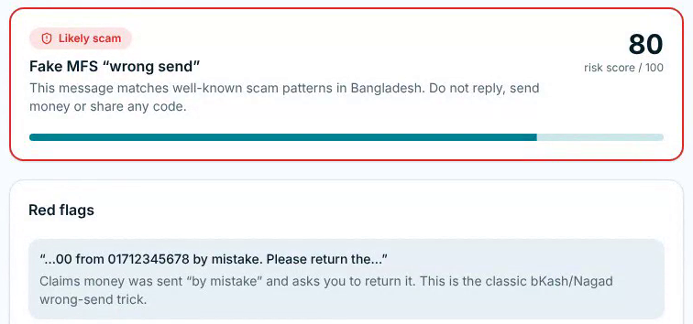
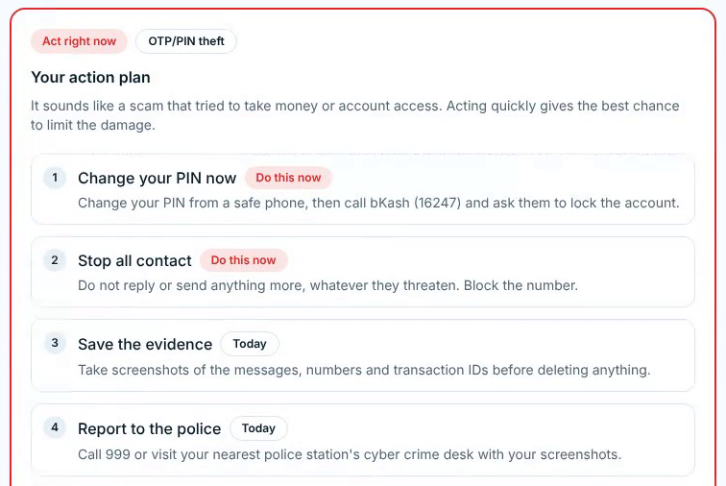
03 · HOW THE SOLUTION WORKS
Three flows, one AI brain
Check
Paste text or a screenshot
AI verdict + risk score
Red flags, next steps, share to family, explain in Bangla
Check: verdict and risk score
Practice
AI writes a realistic message
You guess: scam or genuine
Instant feedback on the red flags
Get Help
Describe what happened
Personal recovery plan, urgency, who to report to
Follow-up Q&A grounded in your own case
Get Help: prioritised action plan
Under the hood: server functions call Gemini Flash (checks, practice) and GPT (recovery plans) through the Lovable AI Gateway, with a rule-based Bangladesh scam-pattern checker as fallback when the AI is busy.
Notes:
Check: paste text or upload a screenshot, choose the channel, and the AI returns a verdict, risk score, red flags, what to do next, a ready-made warning for family, and a one-tap Bangla explanation. Practice: the AI generates realistic messages and you decide scam or genuine, with feedback after each answer. Get Help: describe what happened, whether you sent money or shared a PIN, when and how you were contacted, and get a personal recovery plan, then ask follow-up questions answered from your own incident. AI runs through the Lovable AI Gateway, with a rule-based fallback.

Slide 4






04 · PARTICIPANT INTRODUCTION
A solo build, end to end
Product and research
Mapped the scams most used in Bangladesh and the helplines people need.
Design
Simple, mobile-first screens with a full Bangla toggle for every family member.
Najmun Nahar
AI engineering
Prompts and structured outputs for checking, practice and recovery plans.
Solo participant · Builder of ScamShield BD
github.com/najmunnaharhira
Full-stack development
TanStack Start and React app, Supabase reports, PWA, deployment and demo video.
scamshield.najmunnaharhira.me
Notes:
I am Najmun Nahar (GitHub: najmunnaharhira), a solo participant. I handled every part of ScamShield BD: research into the scams most common in Bangladesh, the design, the AI prompts, the full-stack build and the demo.

Slide 5




05 · OTHER RELEVANT INFORMATION
Safe by design, ready for real families
Private and reliable
Built for everyone
Community and safety
Nothing you check is stored on a server
Check history stays on your own device
Rule-based quick check when the AI is busy
Every screen in English and Bangla
Installable PWA for mobile and desktop
One-tap warning to share on WhatsApp
Report a scam sender; see how often it was reported
Helplines up front: bKash 16247, Nagad 16167, 999
Golden rules and six common scam types
Live app
scamshield.najmunnaharhira.me
Code
github.com/najmunnaharhira/bangla-scam-spotter
Demo video
tinyurl.com/yunet-video
Built for Ostad presents YUNet AIgnite Buildathon 2026 · AI risk estimates, not legal or financial advice
Notes:
Watch the 2-minute demo at tinyurl.com/yunet-video. ScamShield BD keeps checks private, falls back to a rule-based checker when the AI is busy, works in English and Bangla as an installable app, and lets the community flag scam senders. Try it at scamshield.najmunnaharhira.me; the code is on GitHub.

